Slide 1
Computer Graphics in Daily Life & Modern Trends
Overview of Real-World Applications and Emerging Technologies

Slide 2
Applications of Computer Graphics in Daily Life
• Gaming and Entertainment
Used in 2D/3D games, animated movies, and visual effects.
• Education and Training
Interactive simulations and virtual labs improve learning.
• Medical Imaging
MRI, CT scans, and 3D visualization help in diagnosis.
• Engineering and Architecture
CAD software is used for building and product design.

Slide 3
Modern Trends in Computer Graphics
• Artificial Intelligence in Graphics
AI is used for image generation, animation, and automation.
• Virtual Reality (VR) and Augmented Reality (AR)
Provides immersive experiences in gaming and education.
• Real-Time Ray Tracing
Creates realistic lighting and reflections in graphics.
• Metaverse and Digital Twins
Virtual worlds and digital replicas are becoming popular.

Slide 4
Conclusion
Computer graphics play a major role in modern technology.
They improve visualization, communication, and user interaction.
Emerging technologies such as AI, VR, and AR are shaping the future of graphics.

Slide 5
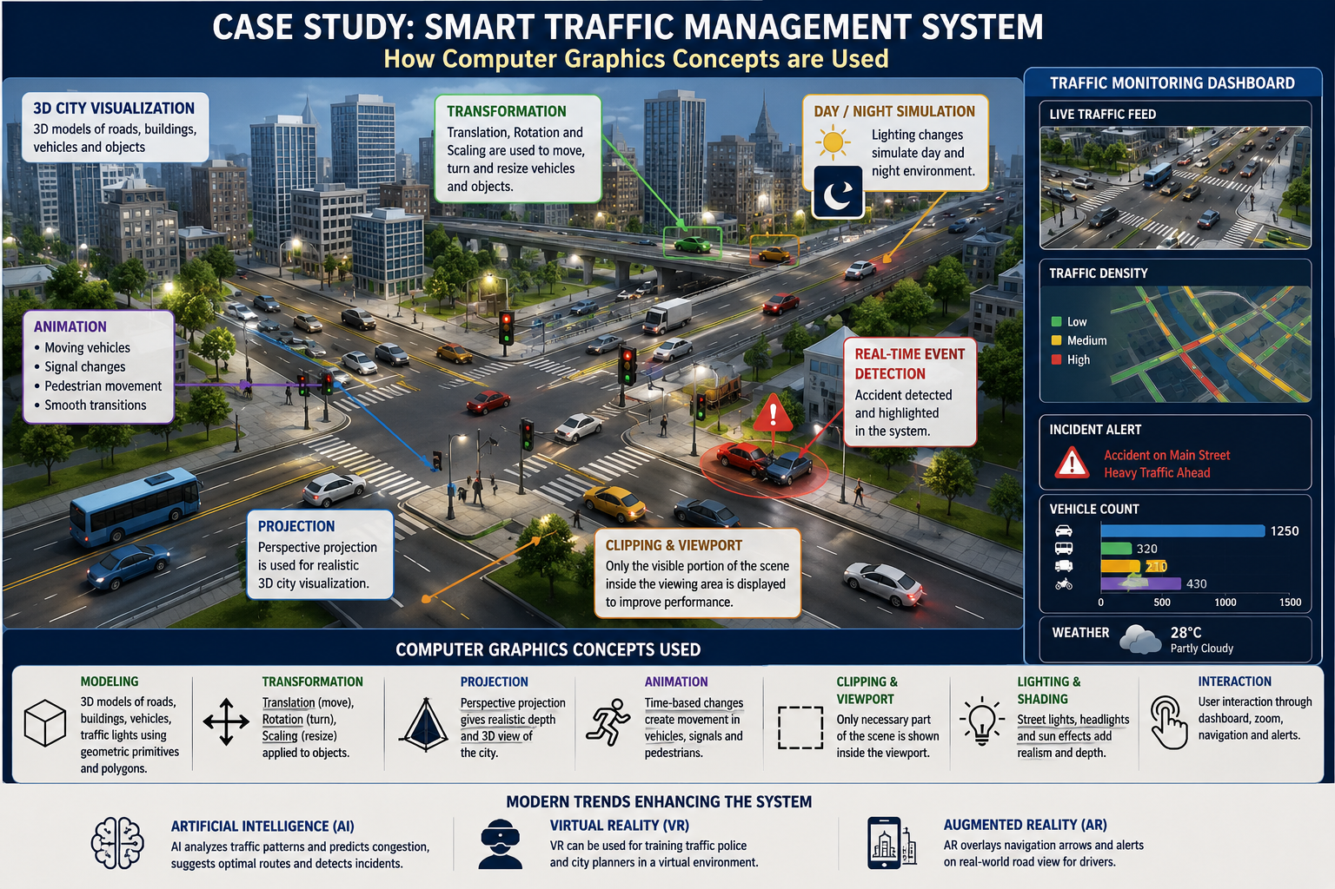

Slide 6
Case Study: Smart Traffic Management System
A software company is developing a Smart Traffic Management System for a city. The system will display 3D roads, moving vehicles, traffic signals, and real-time traffic updates. It will also simulate day/night environments and highlight accident areas.
Students have to analyze how Computer Graphics concepts will be used in this system.
Questions
How will transformations help in moving vehicles?
Which projection technique will be suitable for city visualization?
How can animation be used for traffic signals and cars?
Why are clipping and viewport mapping important?
How will lighting and shading improve realism?
How can AI, VR, or AR enhance the system?
Learning Outcome
Students will understand how Computer Graphics concepts are applied in real-world systems such as smart cities and traffic visualization.

Slide 7


Slide 8
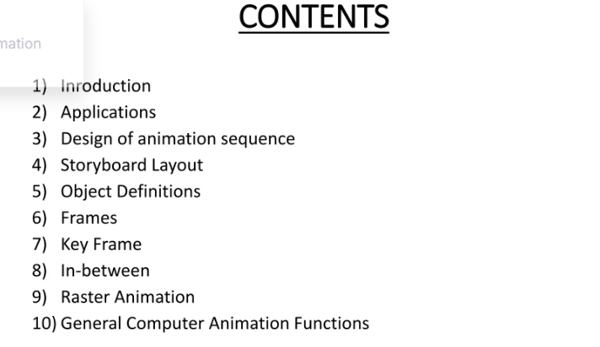

Slide 9
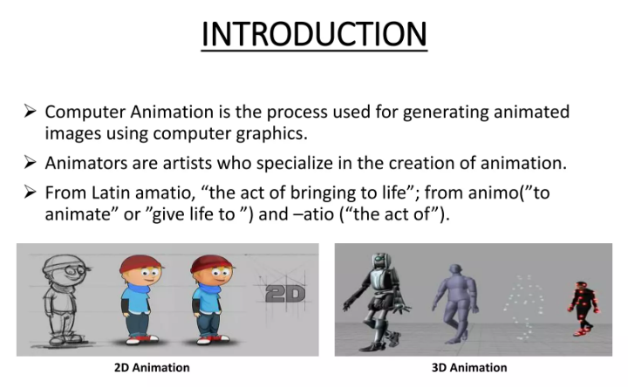

Slide 10
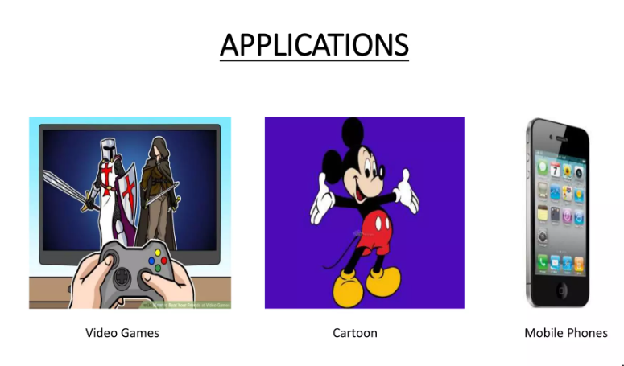

Slide 11
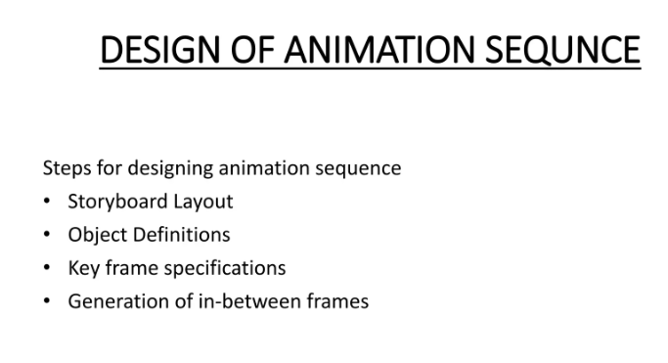

Slide 12
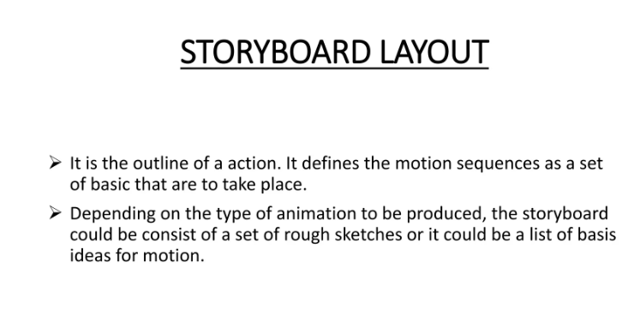

Slide 13
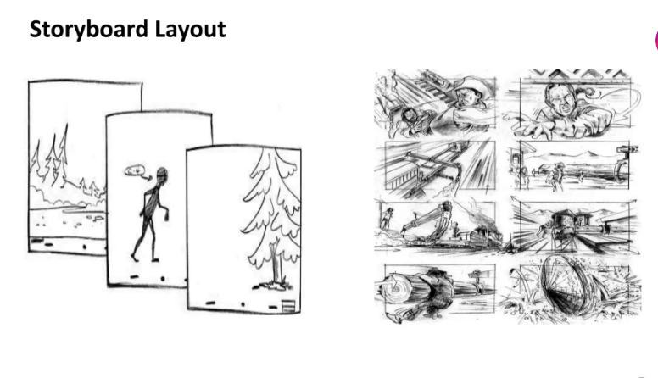

Slide 14
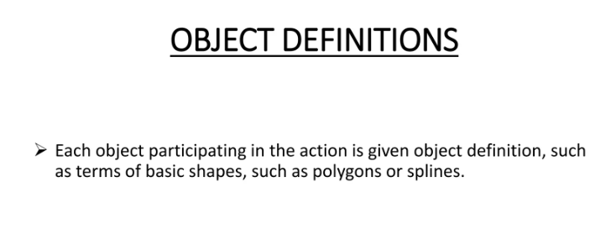

Slide 15
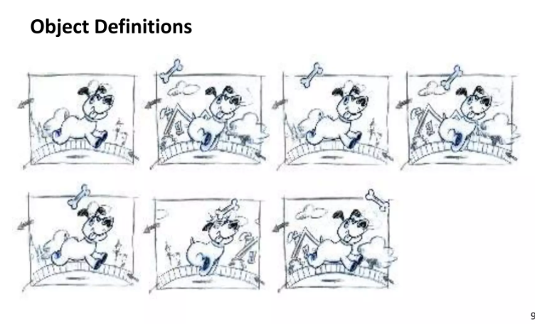

Slide 16
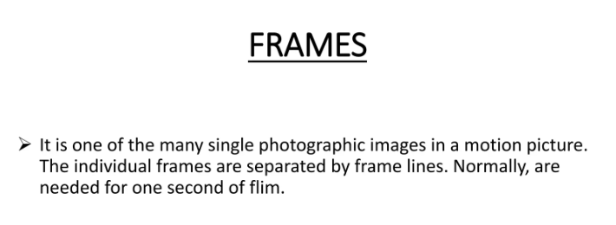

Slide 17
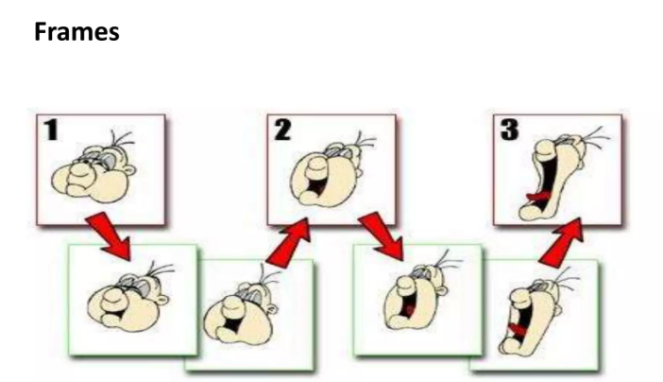

Slide 18
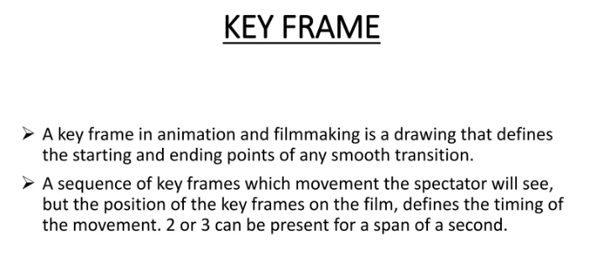

Slide 19
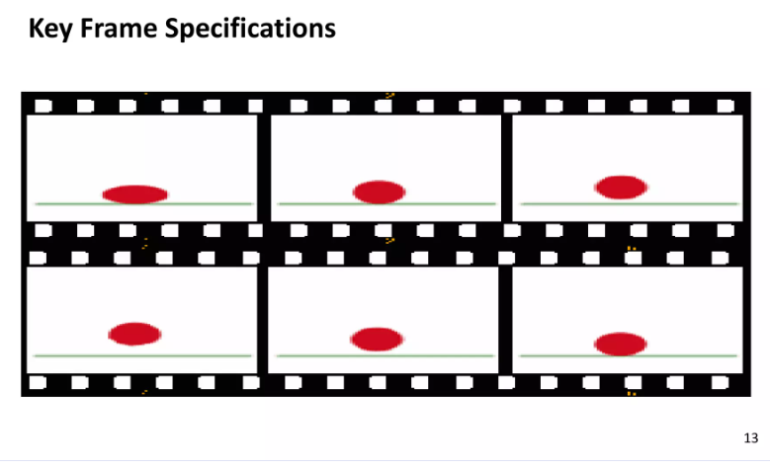

Slide 20
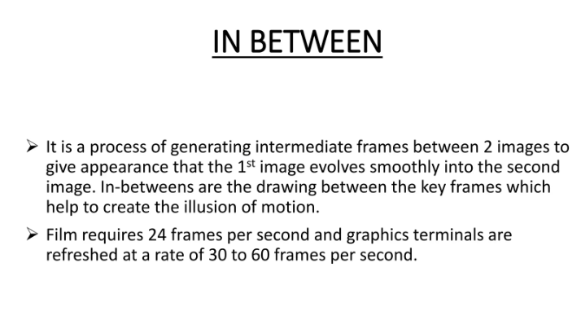

Slide 21
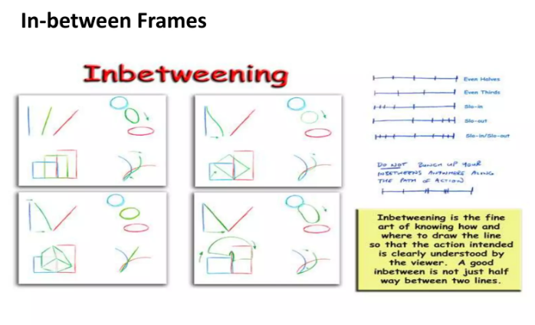

Slide 22
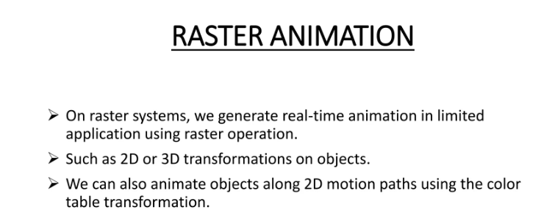

Slide 23
